Slide 1



BIIT 2305 Web Application Development Chapter 8: laravel Mvc model
Instructor :
Dr. Najhan M. Ibrahim
Department of Information Systems
Kulliyyah of ICT, IIUM.

Slide 2
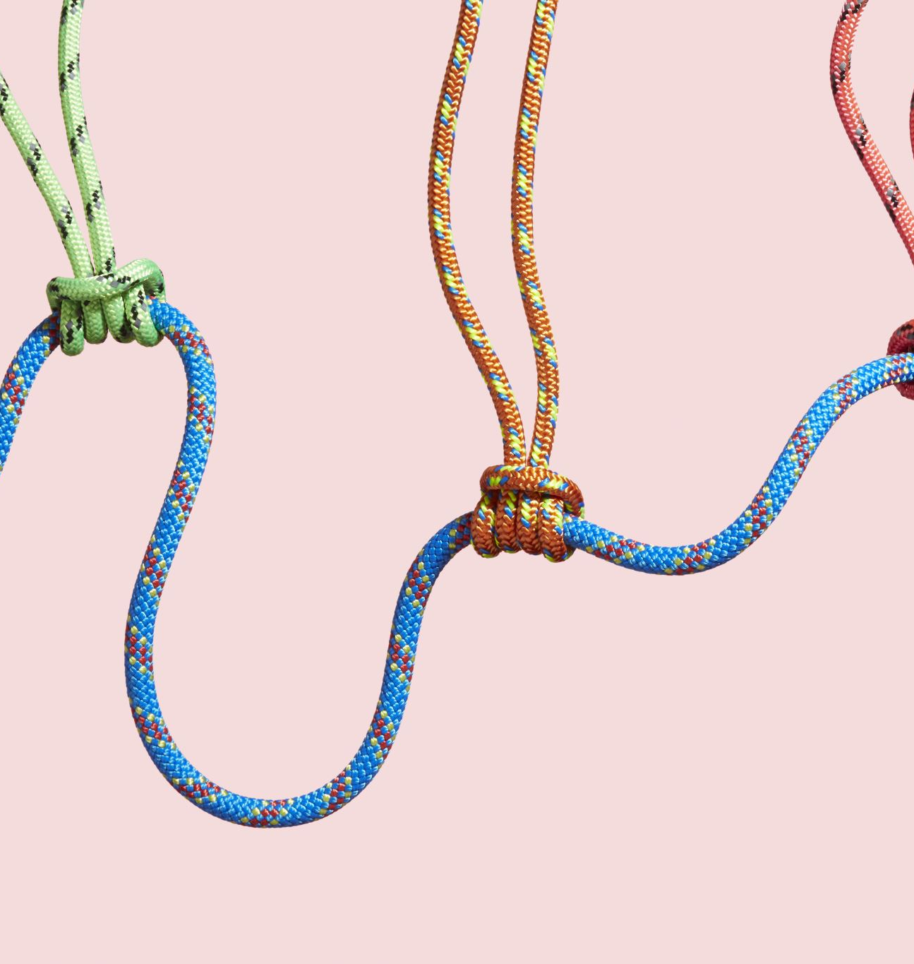


outline
1. MVC concept
2. Route
2.1 what is route
2.2 How to make routing
2.3 Anchor tag (linking page)

Slide 3
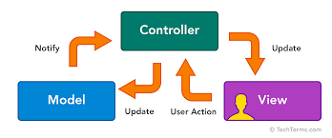
Laravel MVC Model
MVC is an acronym for ‘Model View Controller’.
It represents architecture adoption when building applications.
With the MVC architecture, we look at the application structure with regards to how the data flow of our application works.

Slide 4
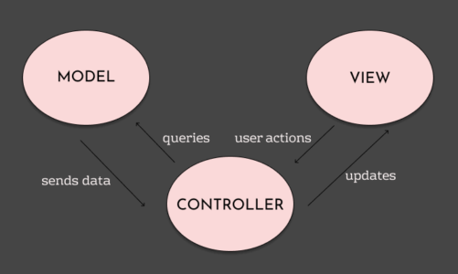
MVC

Slide 5
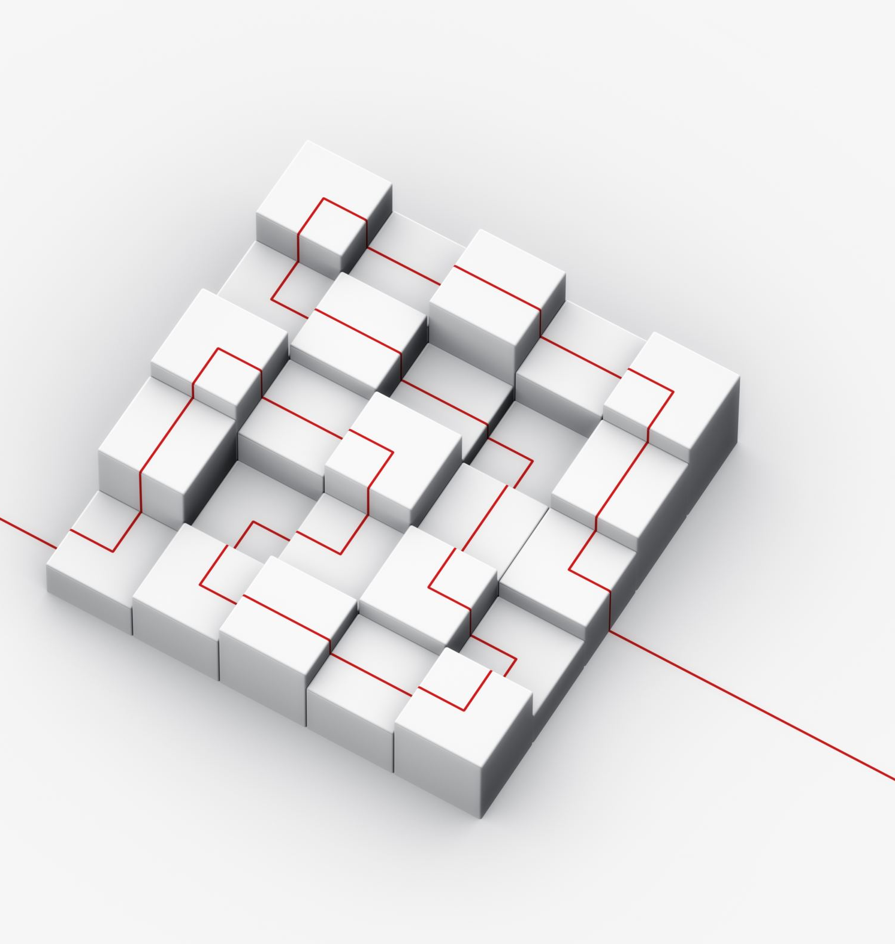
M (Model)
A Model is a PHP class that acts as a blueprint for interacting with a specific table in your database.
Think of a Model as a translator between your PHP code and your relational database. Instead of writing complex, raw SQL queries to get or save data, you interact with your Model using simple PHP methods
It is inside app folder such user.php which extends authenticatable that model mean user is the model

Slide 6

V (view)
The View epresents the "V" in the MVC (Model-View-Controller) architectural pattern. If the Model handles the data and the Controller handles the logic, the View handles the presentation.
It is exactly what the user sees and interacts with in their web browser: the HTML, CSS, and JavaScript. The primary purpose of a View is to separate your application's logic from its presentation, keeping your code clean and organized.
→ Resources
→ View
→ .Blade.php

Slide 7

C (controller)
The Controller represents the "C" in the MVC (Model-View-Controller) architectural pattern. If the Model is the data layer and the View is the presentation layer, the Controller is the brain or the traffic cop of your application.
Its primary job is to connect the user's request to the correct data and the correct display. It sits right in the middle, keeping your database logic (Model) completely separate from your HTML (View).
→ Located in app
→ http
→ controller

Slide 8
Let’s look at a real scenario.
If you go to an e-commerce website, the different pages you see are provided by the View layer.
When you click on a particular product to view more, the Controller layer processes the user’s action.
This may involve getting data from a data source using the Model layer.
The data is then bundled up together and arranged in a View layer and displayed to the user.

Slide 9

What is route?
It is a way of creating a request URL of Laravel web project. The URL does not map to specific files on a website (like html does).
It is available in a [routes] folder. There are two common routes:
Website routes (web.php)
API routes (api.php)

Slide 10
Basic Route

Slide 11
route cont…
The most basic Laravel routes accept a URL and a closure, providing a very simple and expressive method of defining routes and behaviour:
Ex.
use Illuminate\Support\Facades\Route; //Route Library
Route::get('/greeting', function () {
return 'Hello World’;
});

Slide 12
Route verbs
The route verbs telling Laravel to match HTTP methods for various data delivery.
Route Verbs
Route::get(‘/’, function(){});
Route::post(‘/’, function(){});
Route::put(‘/’, function(){});
Route::delete(‘/’, function(){});
Route::any(‘/’, function(){});
Route::match([‘get’,’post’],‘/’, function(){});

Slide 13
Views
Views are files or templates that describe how your output should look like.
Views can be in the form of JSON, XML, email and HTML as the output.
In Laravel, view can be presented by plain PHP or Blade templates. The difference relies on the file extension.
i. about.php – will be rendered by PHP engine.
ii. about.blade.php – will be rendered by Blade engine.

Slide 14
Views
Route::get(‘/url’,function(){
return view(‘welcome’);
});

Slide 15

View Routes
If your route only needs to return a view, you may use the Route::view method. Like the redirect method,
This method provides a simple shortcut so that you do not have to define a full route or controller.
The view method accepts a URI as its first argument and a view name as its second argument. In addition, you may provide an array of data to pass to the view as an optional third argument:
Route::view('/welcome', 'welcome');
Route::view('/welcome', 'welcome', ['name' => 'Taylor']);

Slide 16
Anchor tag (linking page or route)
<h1> Home</h1>
<a href=”URL"> About</a> <br>
<a href="contact"> Contact</a> <br>

